Slide 1

Done by: Lee Ming Han, Sugianto, Brynner Soh, Jeremy Koh, Juay Kai Xun

Slide 2


Company Background
Cold Casket is an established company that specializes in funeral services.
Cold Casket is under the Lee conglomerate.
We provide numerous funeral solutions for all religions while providing a peace of mind to all our customers.
The company motto is : Leave no dead behind.
Cold Casket aims to give everyone, regardless of race, religion and class a proper rite and funeral as they depart for the afterlife.
Not only service, Cold Casket also provides other products such as hearse, coffins , funeral supplies and religious supplies.

Slide 3


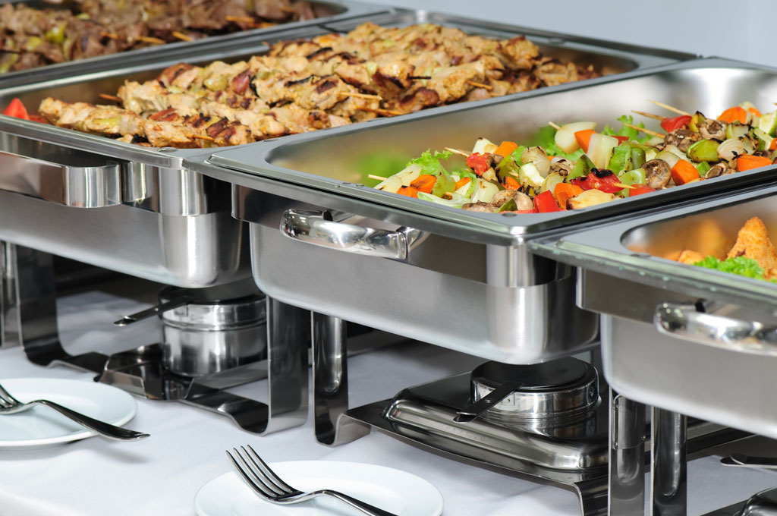
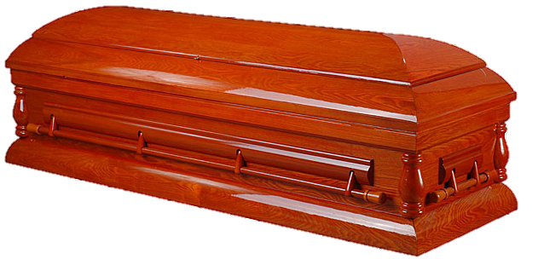


What’s different? (Self-dependence)
We at cold casket at the first company in Singapore that is part of a massive conglomerate.
We have our own in-house lawyer, food catering center (Lee Catering) and do not rely on other vendors for our supplies.
Our catering service, Lee Catering, are not only for funeral services, but for events like party, chalets and meetings.
Besides human food, we also offer catering of pet food for pets who want to spend time with their owner’s last moments.
All of our supplies are from Lee Funeral & Religious Supplies, in order to provide the best possible supplies for our customers.
LEE

Slide 4


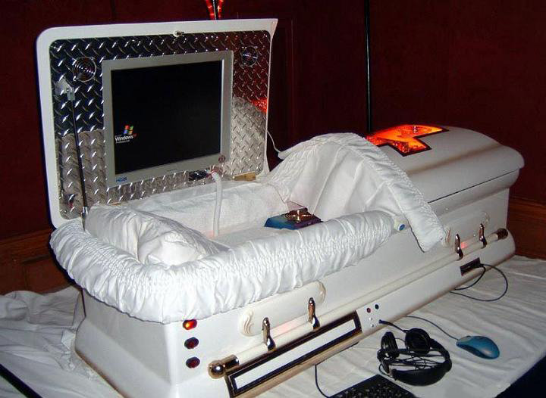
What’s different? (Customized Coffins)
Coming soon in Q3/Q4 of 2017, we will be able to offer customers the ability to customize their own coffin and packages.
Customers can choose from a variety of choices like the materials used , the design and ornament like electronic devices for the coffin.
This allows our customers to build a coffin based on what their deceased family members preferences.
However this is exclusive to customers who have applied for our “Advanced planning” scheme.

Slide 5


Web Pages (and their coding)

Slide 6







Home
For our ‘home page ’ , it contains a Slideshow, Motto and Mission, What we do and Coming soon.
There are very short description for each section stated above.
The slideshow contains images of the various services that we offer and the logo/team picture of our website.

Slide 7
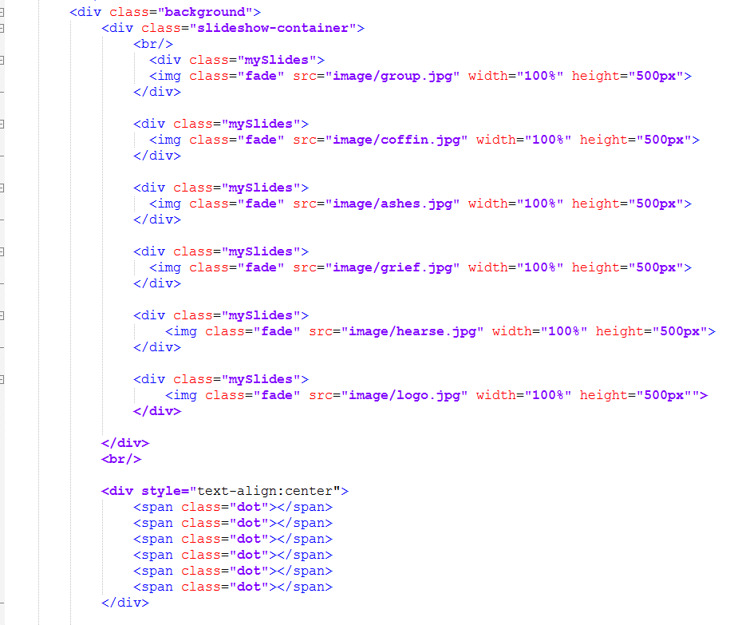
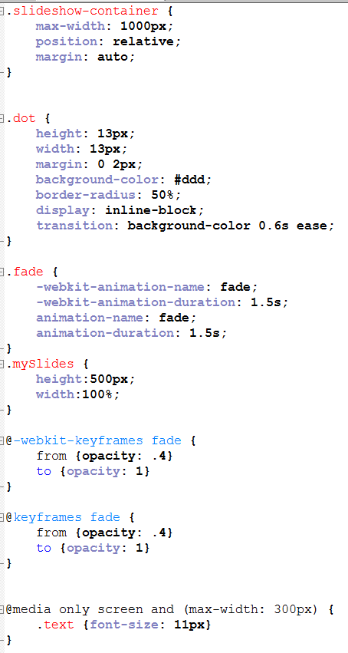
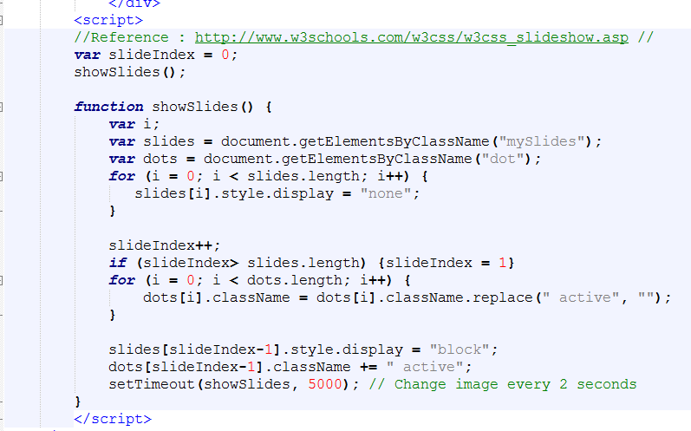

Slide 8

About us
This page is… ABOUT US!
A short description of what our company’s history and how it excels in such a niche industry.
A brief summary of each individual and their traits.
Human Resource Manager
CEO
Advanced Planning Director
Resource Manager
Counsellor

Slide 9
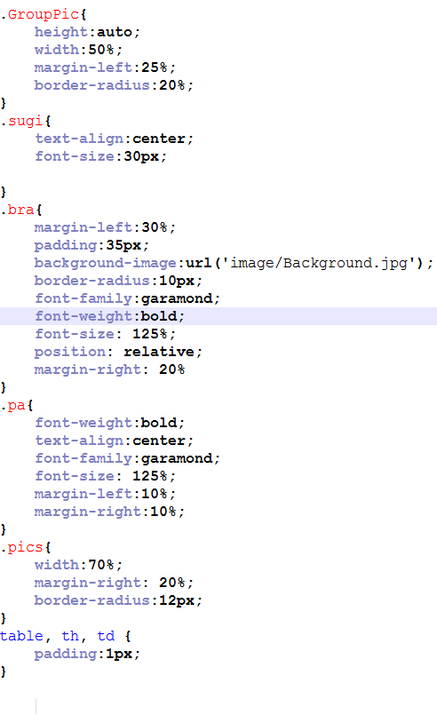
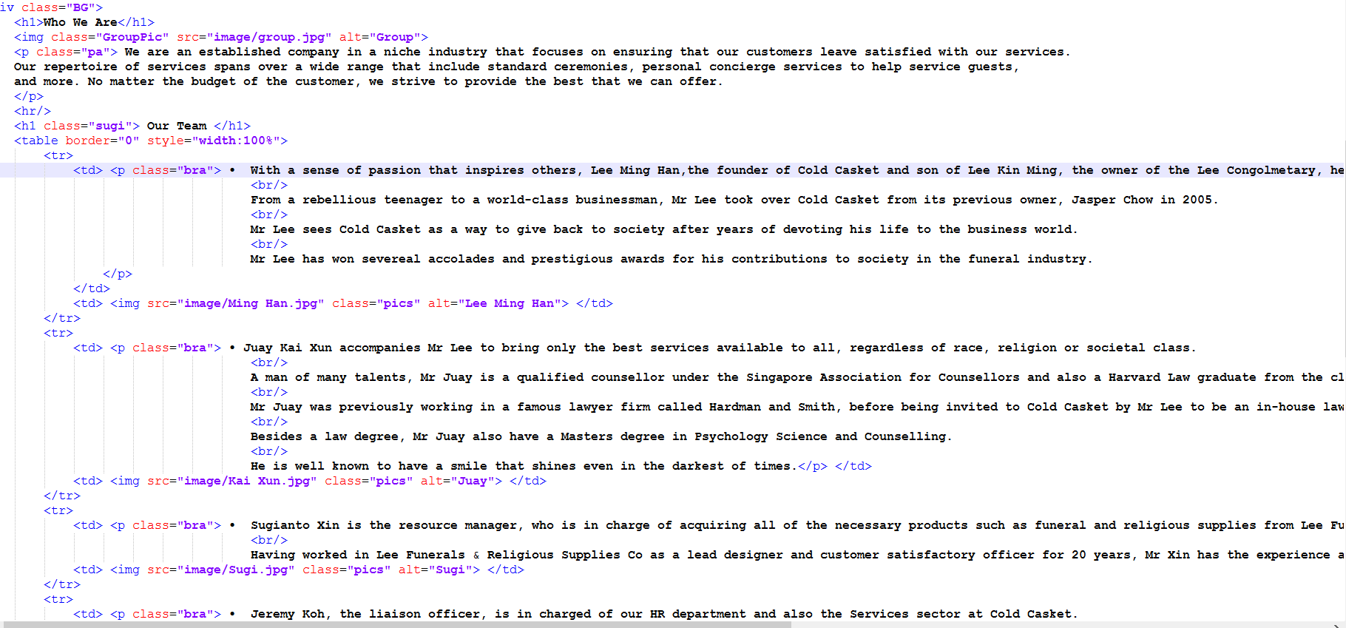

Slide 10
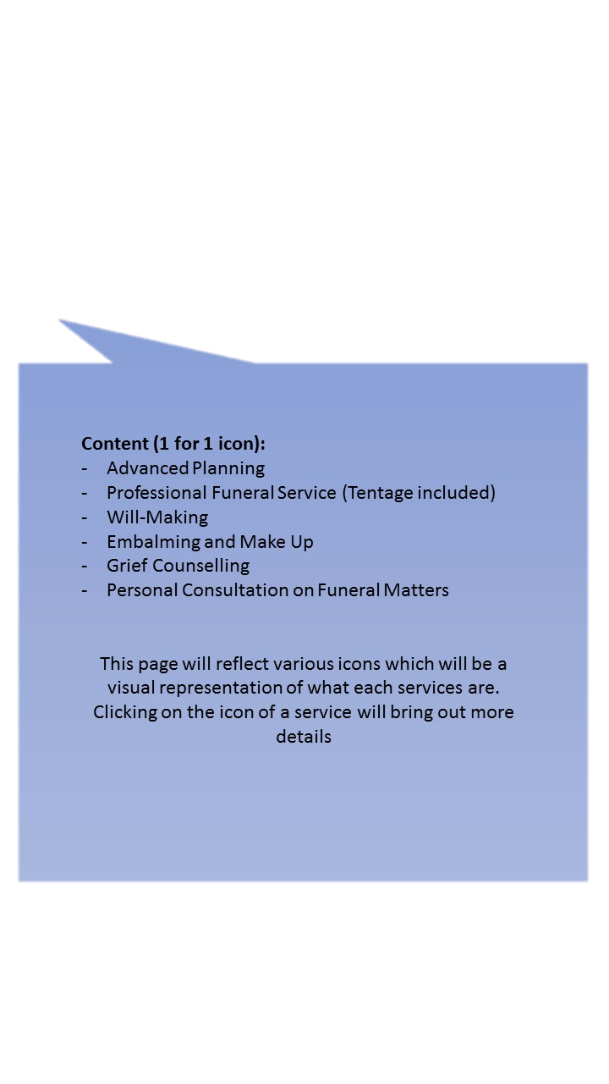
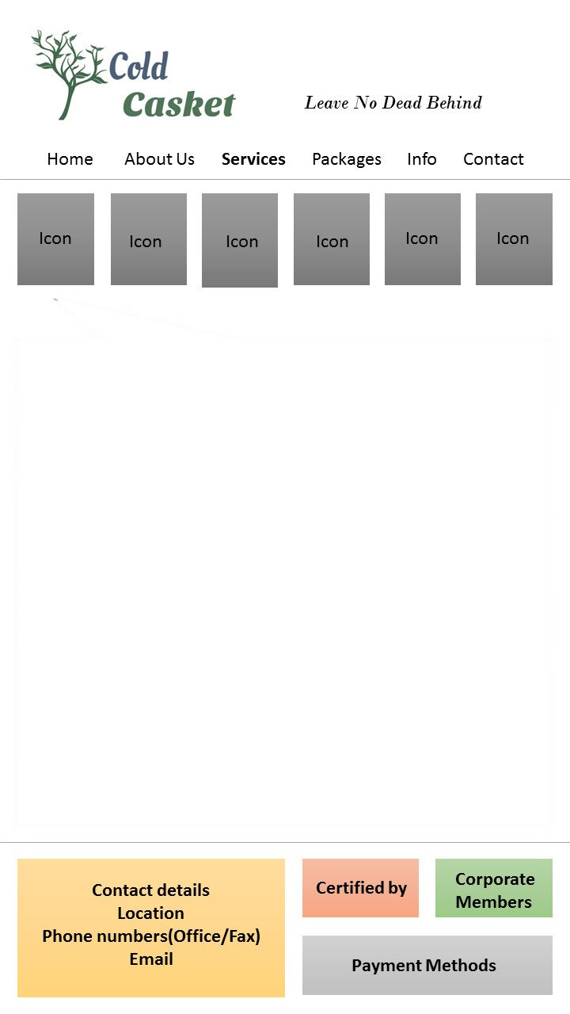




Services
On our ‘Services’ page, we had decided to give it a simple layout.
We used a JavaScript function to display a collapsible feature to hide information of the various ‘Services’.
So when customers click on the picture icon of a certain service, the information will be displayed.

Slide 11
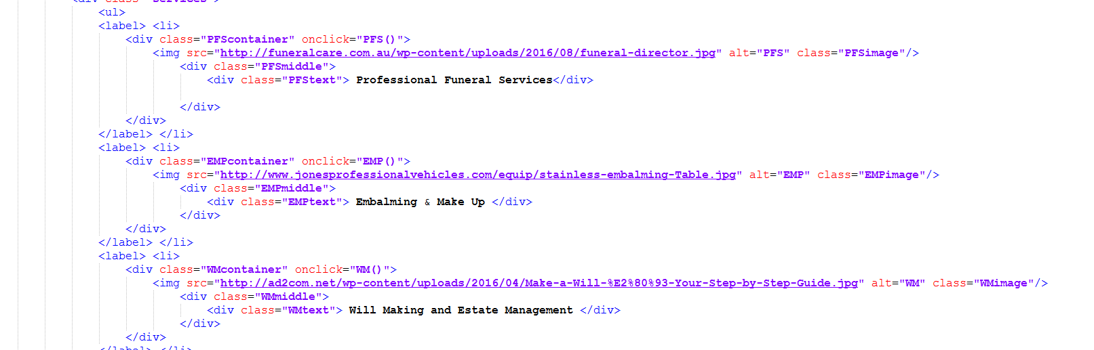
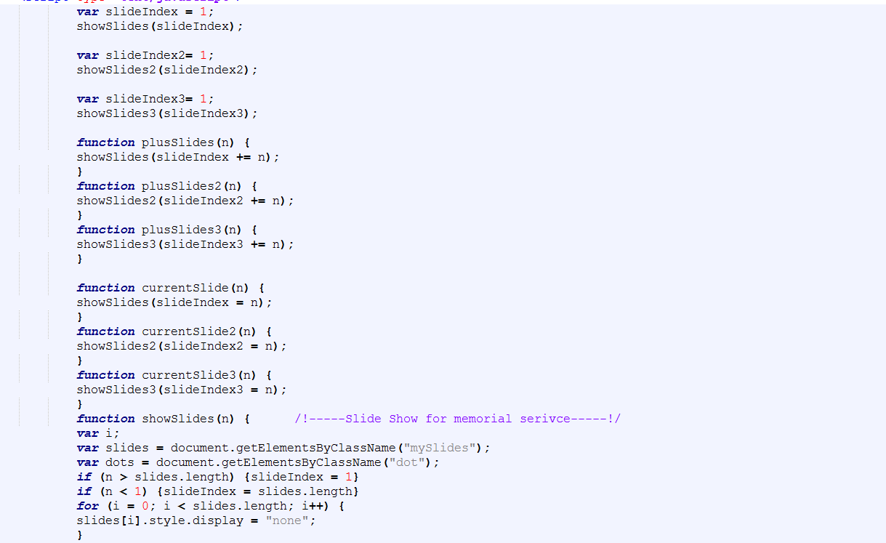
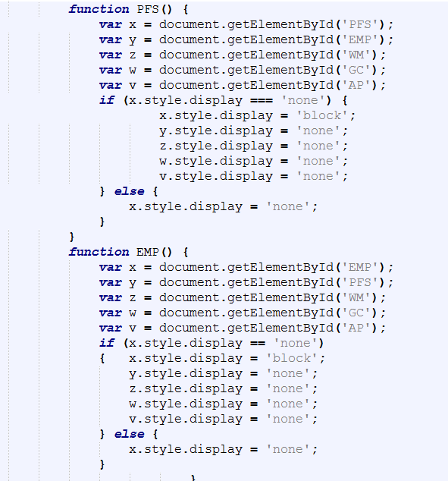
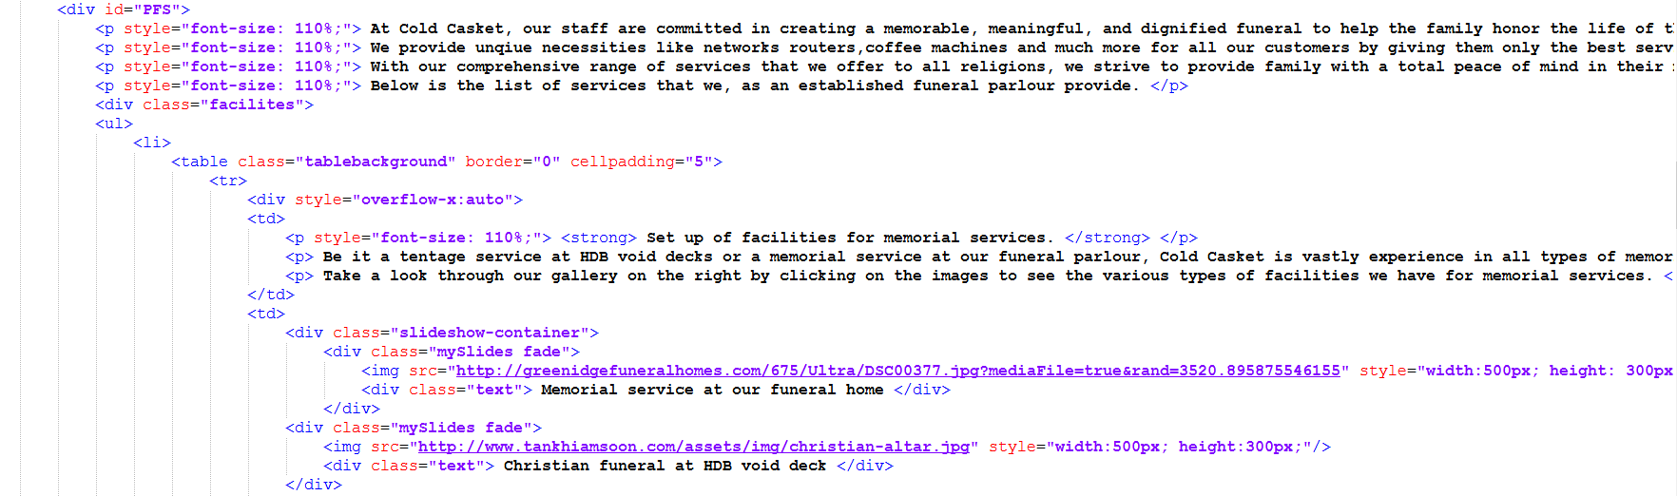

Slide 12
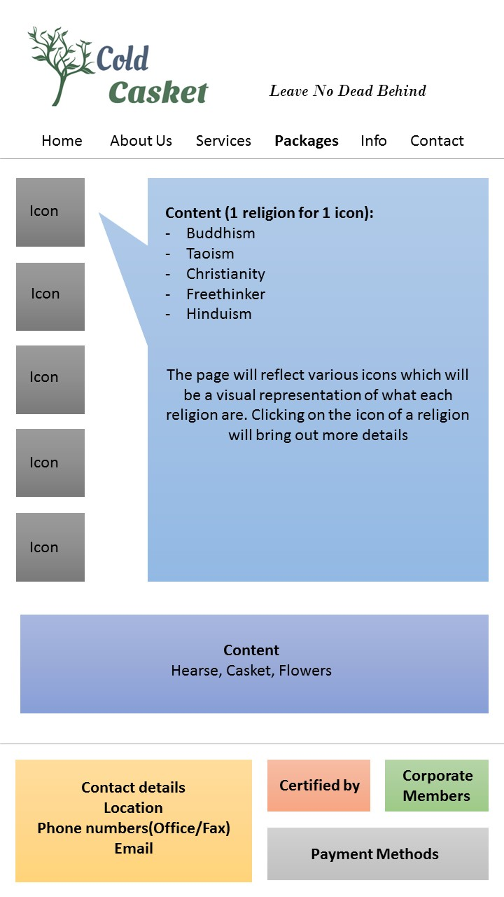





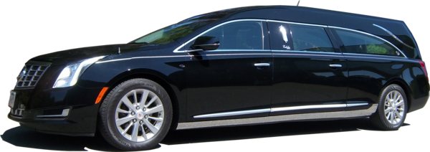



Packages
We used a JavaScript function to display a show and hide feature to show information of the various ‘Packages’.
Include different religious packages like, Buddhism, Christianity, Freethinker, Hinduism and Taoism.
Packages include services and items that we provide for that specific religion.
Mini gallery of hearse, casket and flower at the bottom of the page to show people some of them that we provide to our customer.

Slide 13
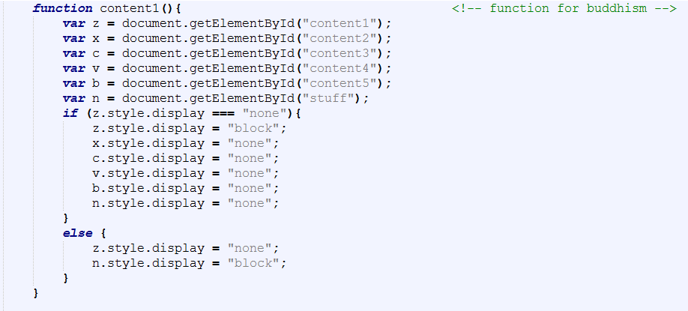
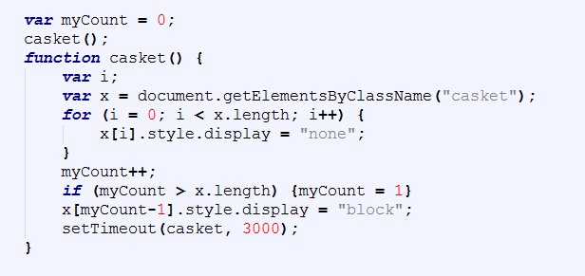

Slide 14

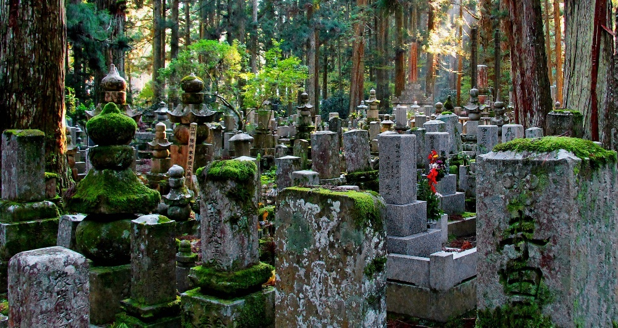
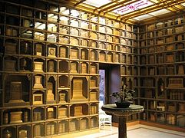
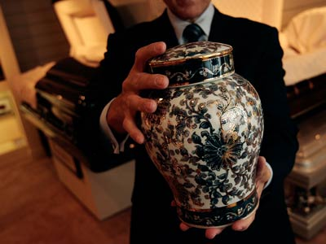

Info
The ‘Info’ page has information regarding what to do when a death occurs and also the list of all the cemeteries, columbarium and crematoriums in Singapore.
It uses a collapsible feature to hide and show only necessary information.
There is also a table under “List of cemeteries, columbarium and crematoriums” with all the various costs for burial, cremation and columbarium urn storage.

Slide 15
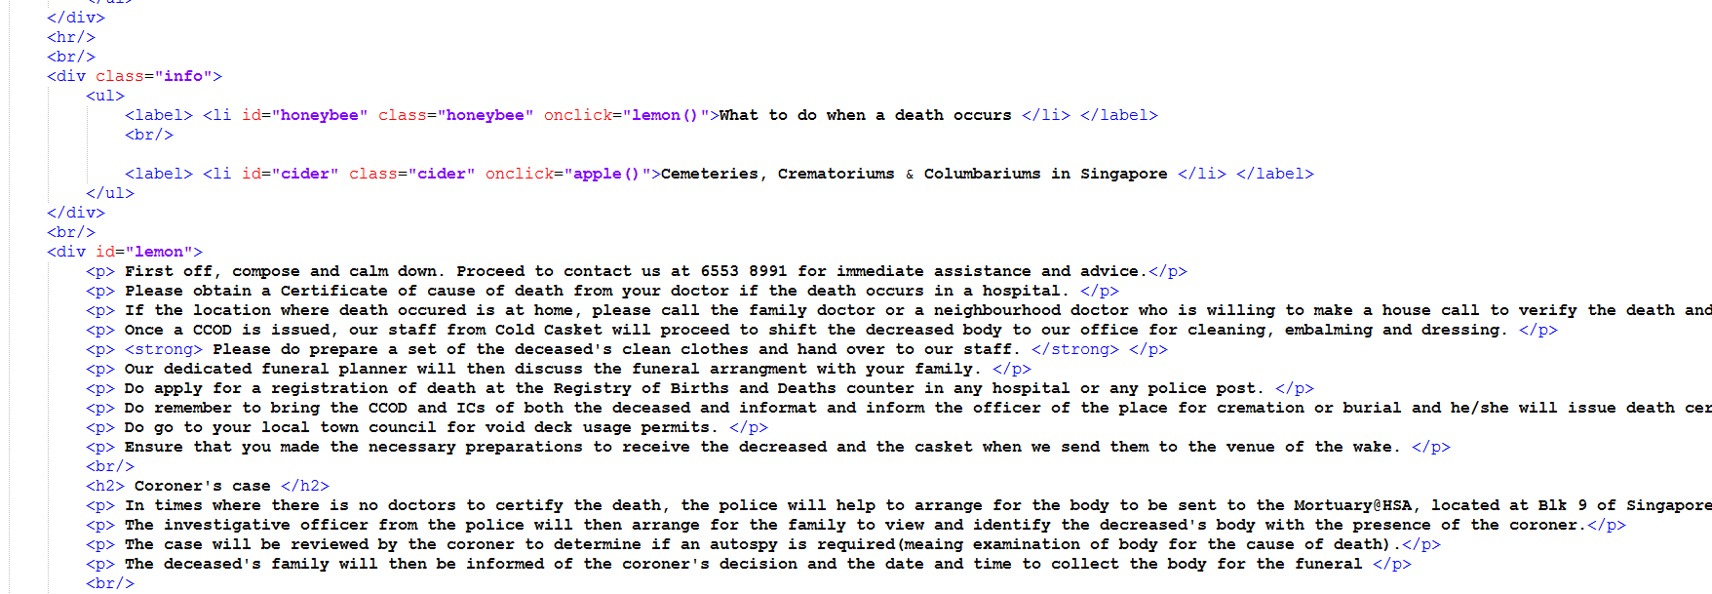
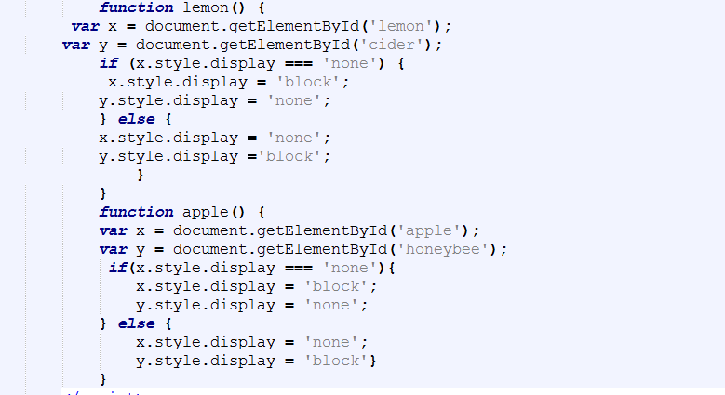
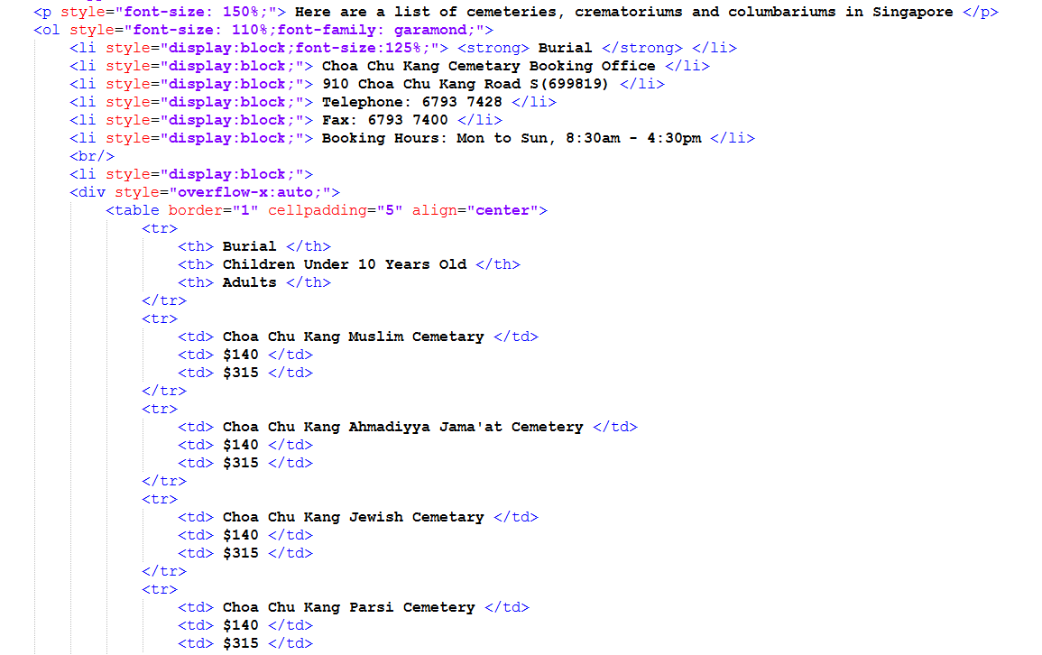

Slide 16

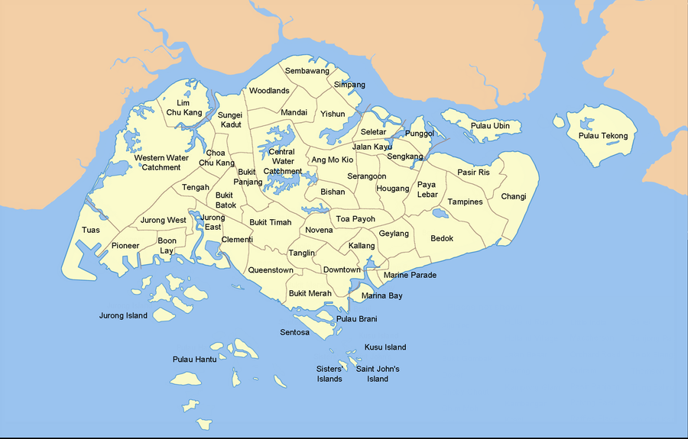


Contact us
Map location helps customers to navigate to our location without any trouble.
Details (HELPLINE) for want to know how or where to contact us and those who are in DIRE need of our services and cannot wait for us to reply through form or email.
Basically, we need a form, map location and the details of the contact us page.
Form is used for customers who want to arrange a funeral or have enquires regarding our service in general.

Slide 17
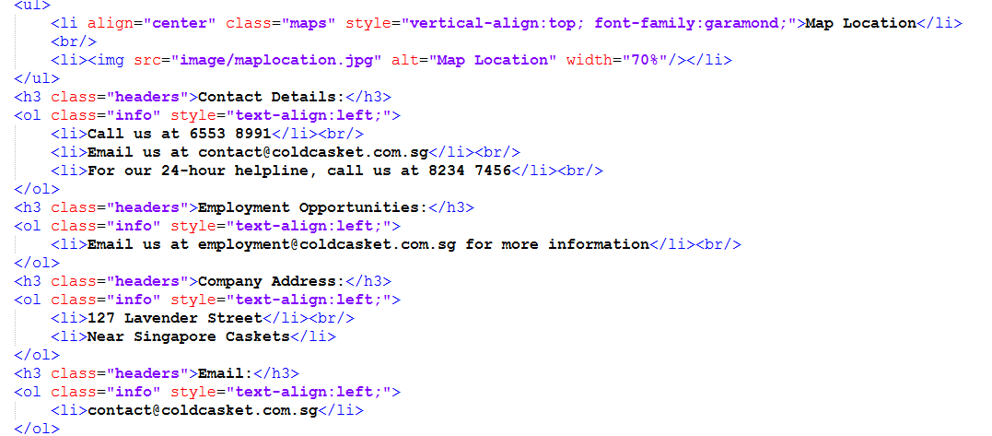
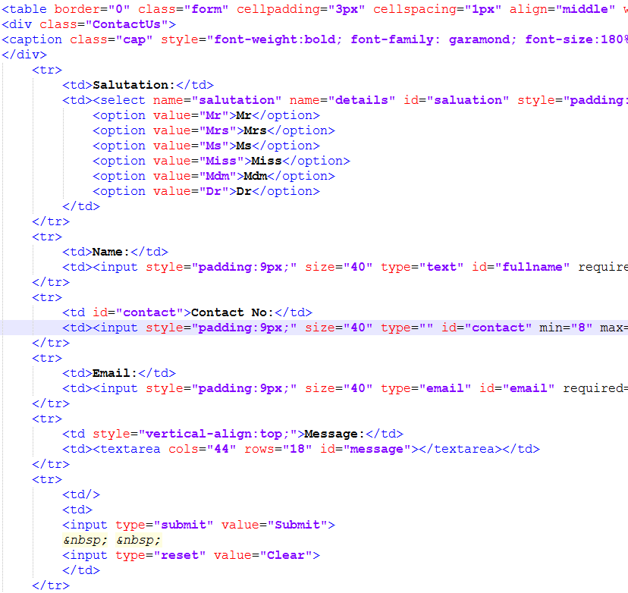
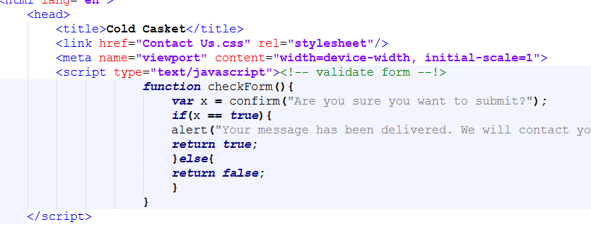

Slide 18


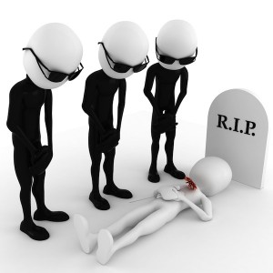

Conclusion
Cold Casket strives harder to become the best in the funeral industry in terms of services that have both quality and quantity.
Also we want to provide the best service to the customers when they are in need of our help.
Just like our motto, Leave No Dead Behind, we will strive to ensure that no customers leaves unsatisfied and we hope to continue improving.

Slide 19
Thank You

